Slide 1
Calendar Year (CY) 2014 Cost Reporting Training
Comprehensive Community Services (CCS) and Wisconsin Medicaid Cost Reporting (WIMCR)
Division of Health Care Access and Accountability
Wisconsin Department of Health Services

Slide 2

Agenda 1: CCS
CCS overview and policy update, DHS
  CCS program overview
  CCS county participation
  Roles and responsibilities
  2014 regionalization
  CCS financial process
  2014 billing updates
  WIMCR and CCS background
Questions and answers
Break

Slide 3

CCS Overview and Policy Update
Steven Kulig, Wisconsin Department of Health Services

Slide 4
What Is CCS?
CCS stands for Comprehensive Community Services.
Mental health and substance abuse program.
Provides programming to people of all ages—youth to elderly—living with a mental illness and/or substance use disorder.
CCS is for individuals who need ongoing services beyond occasional outpatient care, but less than the intensive care provided in a hospital setting.
The individual works with a dedicated team of service providers to develop a treatment and recovery plan to meet the individual's unique needs and goals.
A 2013 study of the consumer experience in CCS found that this targeted, community-based approach is effective in promoting better overall health and life satisfaction.
CCS reduces an individual's reliance on costly high-end services, such as emergency room visits.

Slide 5
Participating CCS Programs by Year
*Estimated CCS programs

Slide 6
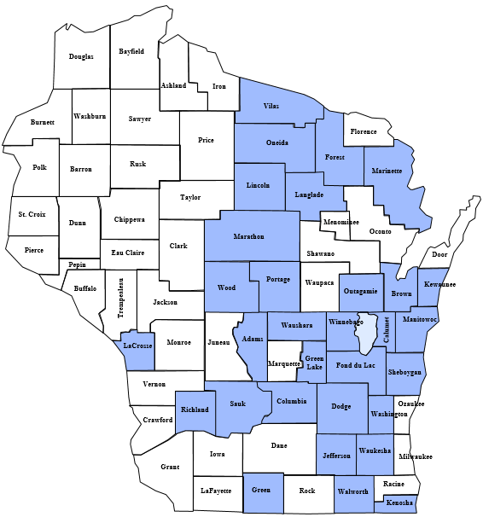
Participating CCS Programs
Prior to Regionalization Effective July 1, 2014
CCS counties
(31 counties total, including counties part of 51.42 agencies)
Non-CCS counties

Slide 7
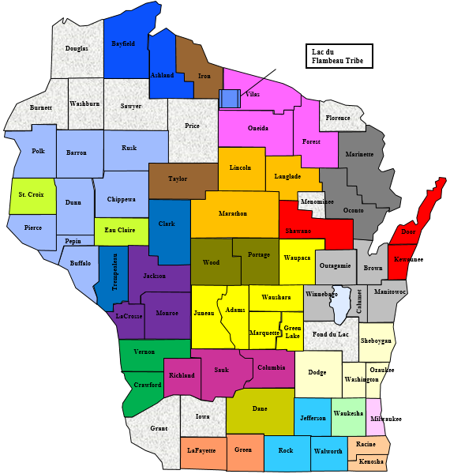
Participating CCS Programs
Regional Participation as of April 1, 2015
63 counties and one tribe currently in CCS (includes Fond du Lac as non-regional participant)
Color coding reflects 24 regional CCS entities:
  21 county-based programs
  2 51.42 programs
  1 tribal-based program

Slide 8
Total Interim CCS Claim Payments
By Annual Dates of Service (in Millions of Dollars)

Slide 9
Regional Claims by Quarter
Percentage Breakdown of Regional and Non-Regional Claims (July 2014–March 2015)
Type | Jul–Sep | Oct–Dec | Jan–Mar
Non-Regional Claims | 42% | 11% | 4%
Regional Claims | 58% | 89% | 96%
All Claims | 100% | 100% | 100%

Slide 10
Update to CCS Billing
Legacy CCS billing (eliminated after June 30, 2014)
  Procedure code H2018: psychosocial rehabilitation services, per diem
CCS billing updates (effective July 1, 2014)
  Procedure code H2017: psychosocial rehabilitation services, per 15 minutes
  Modifiers indicate professional type and identify services provided in a group setting
CCS billing note: billing vs. rendering provider IDs
A billing provider is the billing entity (county or tribe) that submits the interim claim.
A rendering provider is the entity that rendered the service.
Rendering provider ID may differ from billing provider ID for multi-county region.
CCS claims should reflect the rendering provider ID.

Slide 11
CCS Financial Process
Legacy method (through June 30, 2014)
  Annual rate setting
  Interim billing and CCS claims payments
  Year-end cost reporting and financial reconciliation
Updated method (effective July 1, 2014)
  Statewide rates
  Interim billing and CCS claim payments
  Updated annual cost reporting and reconciliation method
Note: CY 2014 reporting incorporates both legacy and updated reporting methodologies.

Slide 12

CCS CY 2014 Cost Reporting Process
Legacy CCS reporting
  Applicable for dates of service from January 1, 2014, to June 30, 2014
  Consistent with past CCS reporting
Updated CCS reporting
  Applicable for dates of service from July 1, 2014, to December 31, 2014
  Based on CY 2013 WIMCR reporting methodology

Slide 13
CCS Policy Next Steps
CY2014 Reporting
  Currently, CCS and WIMCR have two different cost reports but have similar reporting criteria.
Beginning in CY 2016 for CY2015 reports
  Moving toward cost report integration between CCS and other county-based health services programs for CY 2015 reporting
    Integration would result in a single annual cost report for WIMCR and CCS in CY 2015.
    Cost settlement will continue to be calculated independently for each program.
  Pending federal approval
    Policy changes that affect Medicaid programs require approval by the Centers for Medicare and Medicaid Services (CMS).
    All anticipated updates are subject to change pending federal approval.
  Broader vision to include additional mental health programs
    CCS is the first program to integrate with WIMCR reporting methodology.
    Additional mental health programs may be included at a later date.

Slide 14

CCS and WIMCR CY 2014 Cost Reporting and Demonstration of the Reporting Tool
Megan Morris and Nora Boyle, PCG

Slide 15

Agenda 2: CY2014
Reporting
CCS/WIMCR Process
WIMCR first-time users
CCS/WIMCR reporting and demonstration
Timeline/next steps

Slide 16
CCS/WIMCR Process

Slide 17

CCS Regionalization
CCS regions must complete three steps:
  Division of Mental Health and Substance Abuse Services (DMHSAS) approval
  Division of Quality Assurance (DQA) certification
  Medicaid provider enrollment
Regional formation
  Initial formation of a region may occur at the beginning of a month from July 1, 2014, to December 31, 2015.
  One annual update to regional structure is allowed (first of the month).
  Effective January 1, 2016, additions and removals must occur on January 1.
Regionalization incentive
  Non-regional CCS providers will continue to receive only the federal share of reimbursement.
  Regional CCS providers will realize enhanced CCS payments through interim claiming and a cost-based reimbursement method.

Slide 18
CCS Regional Models
Multi-County Model
Multiple counties/tribes partner together to operate a regional CCS program across their counties/tribes; a lead county or tribe is identified.
County 2
Lead County 1
County 1
County 3
County 4
County 2
County 4
County 3
51.42 Model
Multiple counties that have partnered together to form a separate 51.42 legal entity operate a regional CCS program through the 51.42 entity.
Population-Based Model
A single county with a population exceeding 350,000 residents, or a single tribe, regardless of population size, operates a regional CCS program.
51.42, County or Tribe 1

Slide 19
CCS/WIMCR Roles and Responsibilities
FEDERAL MEDICAID OVERSIGHT
Centers for Medicare and Medicaid Services
Sets federal requirements
STATE OVERSIGHT
Department of Health Services
Determines requirements for Wisconsin
OPERATIONAL & PROJECT OVERSIGHT
Public Consulting Group
Assists counties with program requirements, completes desk review
DAY-TO-DAY OPERATIONS AND OVERSIGHT
Counties and Agencies
Manages all program requirements, maintains compliance, completes cost report

Slide 20
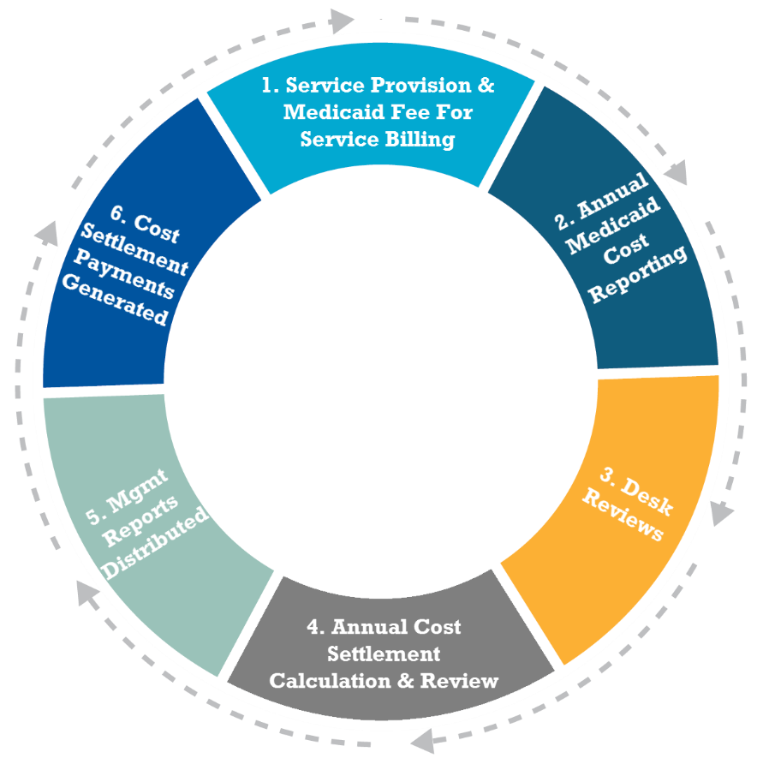
CCS/WIMCR Cost Settlement Cycle

Slide 21
Cost Reporting Requirements
Reimbursement for local government services, other than ambulance services, will be based on the county’s actual cost to provide the services.
Costs reported by each agency must be:
  Accurate.
  Complete.
  Consistent with supporting documentation maintained by each agency.

Slide 22
First-Time Users

Slide 23
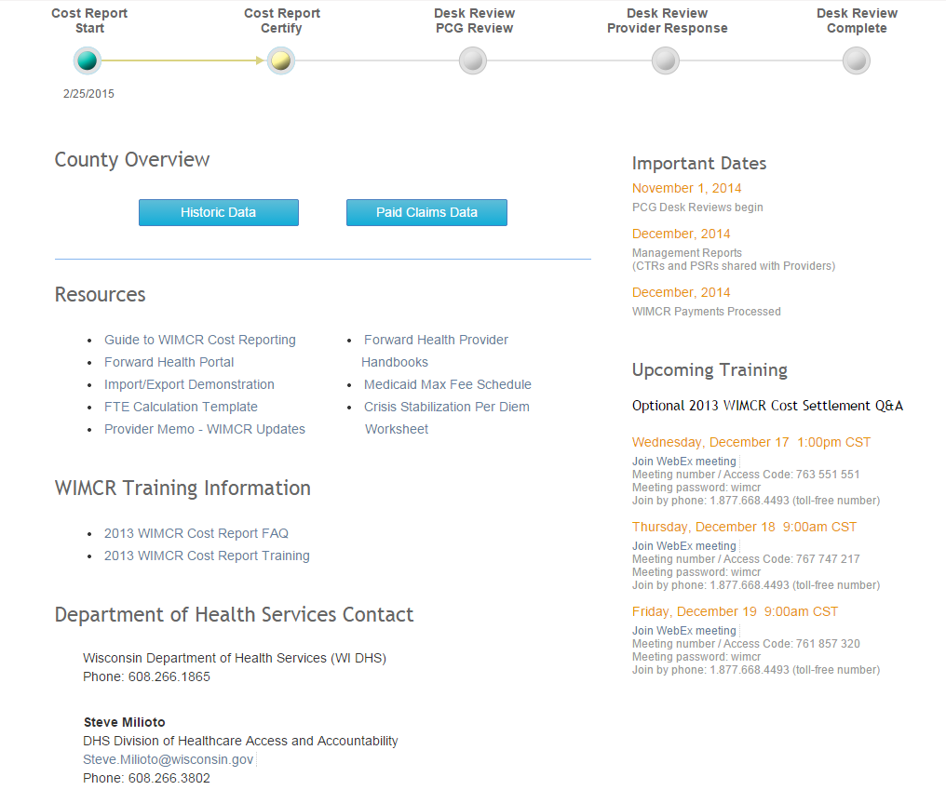
Dashboard
Progress bar
Agency overview
Resources
Important dates

Slide 24
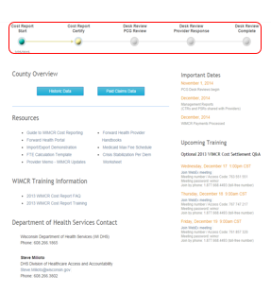
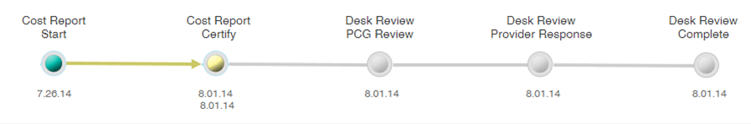
Progress Bar
The progress bar identifies the status of the WIMCR Cost Report for the current period.
Once the user completes the work associated with checkpoint, the circle for that item will turn green with an arrow, indicating the status of the next task prior to the next checkpoint.
The progress bar will also include the date of the last activity for each checkpoint.
Once the cost report is certified, the progress bar will indicate the date the certification was completed below the Cost Report Certified checkpoint.

Slide 25
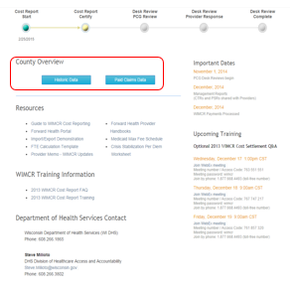
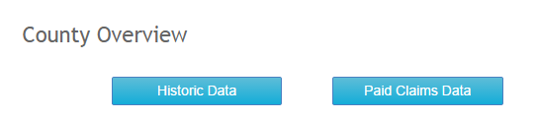
County Overview: Historic and Paid Claims Data
Historic data:
  The Historic Data section will provide an overview of the county agency's historical performance in the WIMCR program.
  The data will display the WIMCR payments, the Maintenance of Effort (MOE) amounts, and the Act 318 adjustments for the most recently completed years.
Paid claims data:
  The Paid Claims Data section will provide a summary of the claims activity of the county agency by WIMCR program.
  This will include data for the current WIMCR year.

Slide 26
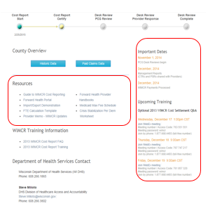
Important Dates and Resources
The Important Dates section will be used to communicate important dates related to WIMCR, such as deadlines for submission of the cost report, desk review completion dates, dates when the WIMCR reports will be available, and upcoming WIMCR training dates.
The Resources section will provide quick access to some of the important documents and will also contain recent training materials, frequently asked questions, and links to external sites such as the ACCESS Wisconsin Portal.

Slide 27
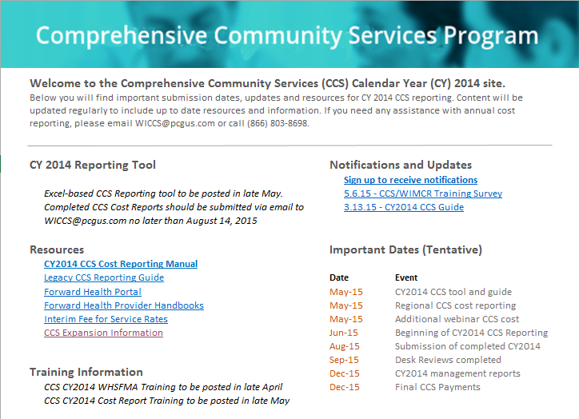
CCS Resources
Resource | Link
CCS CY 2014 reporting: CCS reporting tool Cost reporting instruction manual Notifications and updates Resources Important dates Training information Contact information | wimcr.com/ccs
CCS expansion | dhs.wisconsin.gov/ccs/expansion
CCS notification sign-up | surveymonkey.com/r/67YZRLJ
ForwardHealth portal | forwardhealth.wi.gov

Slide 28
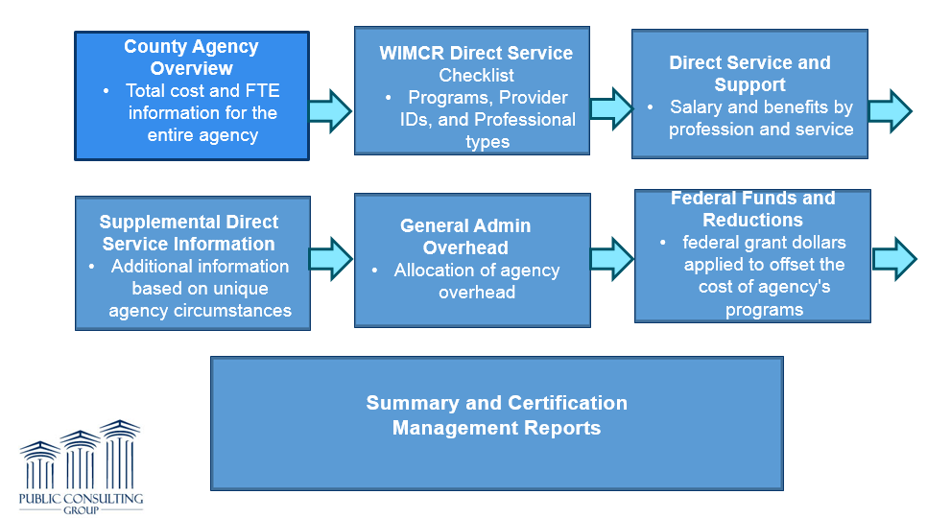
CCS/WIMCR Cost Settlement Overview
Methodology

Slide 29
CCS/WIMCR Cost Report Requirements and Demonstration

Slide 30
CCS/WIMCR Cost Report Data Elements
Medicaid allowable costs and cost report data elements for the WIMCR program:
General information (CCS)
Regional information (CCS)
County agency overview (CCS/WIMCR)
Legacy CCS report (CCS)
WIMCR direct service checklist (CCS/WIMCR)
WIMCR direct service and support (CCS/WIMCR)
Supplemental direct service information (CCS/WIMCR)
General administration and overhead (CCS/WIMCR)
Federal funds and reductions (CCS/WIMCR)
Summary and certification (CCS/WIMCR)
www.pcghealth.com | CCS/WIMCR 2014 Cost Report

Slide 31
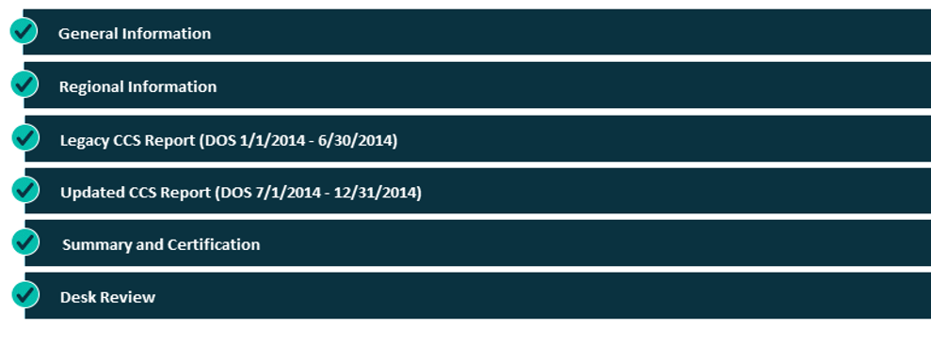
CCS Cost Report

Slide 32
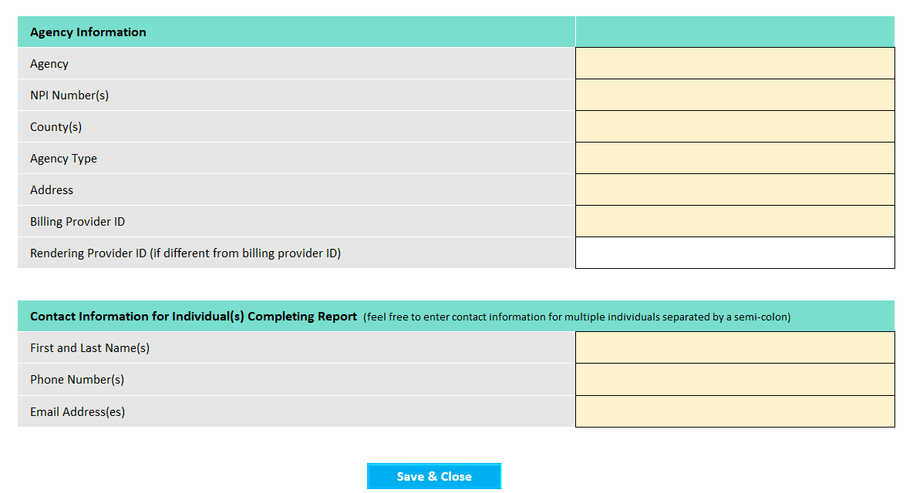
CCS General Information

Slide 33

CCS Regional Reporting
Population-based regions and 51.42 boards
  Single consolidated cost report
Shared services and multi-county regions
  Individual report for each county
  Intergovernmental revenue offsets for regional shared clinicians and other expenses
New Regional Information section
  Name and ID of region
  List of all counties in region
  Date of regional formation
  Subsequent regional adjustments

Slide 34
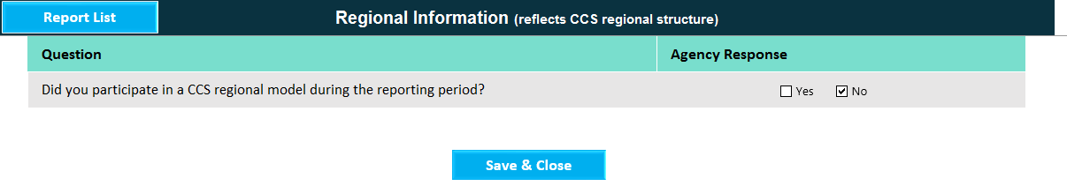
Regional Information
Counties report if they participate in a CCS region.

Slide 35
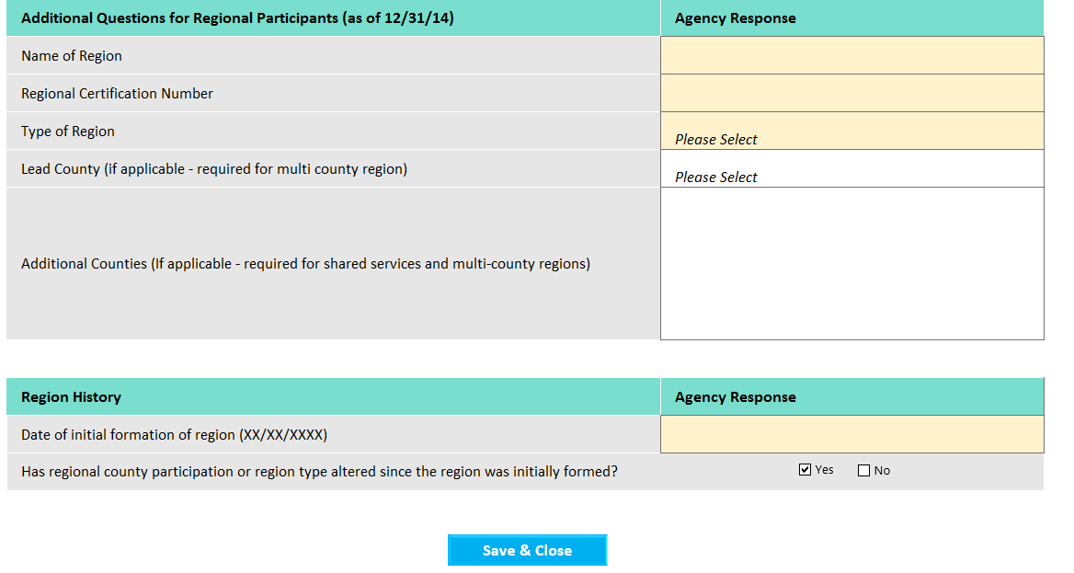
Regional Information
If counties participate in a CCS region, they must complete the regional data fields.

Slide 36
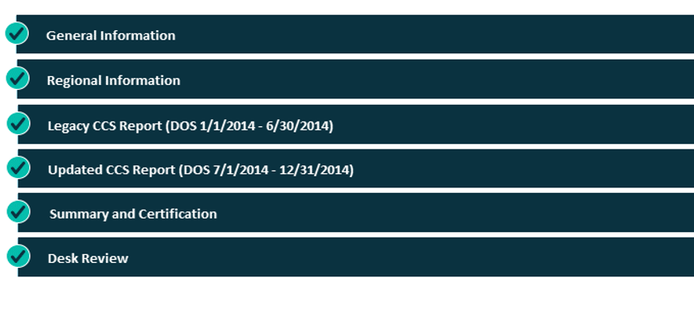
Legacy CCS Reporting
January 1, 2014, to June 30, 2014
36

Slide 37
Legacy CCS Report
Legacy method should only be reported for dates of service through June 30, 2014. Legacy CCS should be familiar to counties who have been billing for CCS services. Legacy CCS reporting should be based on:
Annual rate setting.
Interim billing and CCS claims payments.
Year-end cost reporting and financial reconciliation.

Slide 38
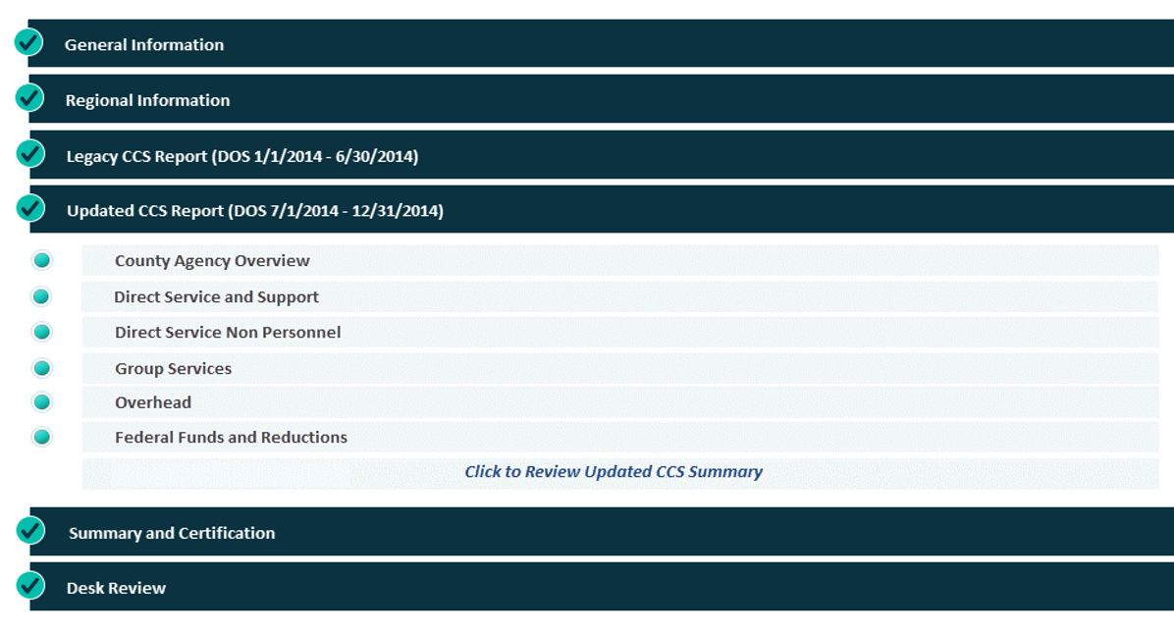
CCS Updated CCS Report:
County Agency Overview

Slide 39
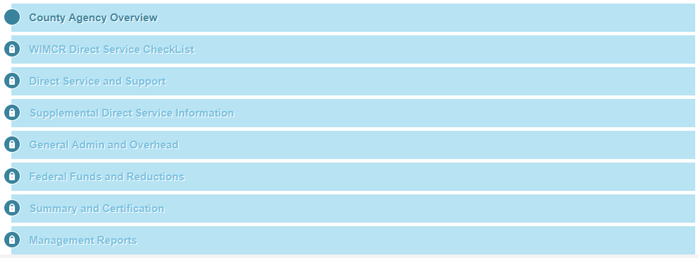
WIMCR County Agency Overview

Slide 40
CCS/WIMCR County Agency Overview
The County Agency Overview page is a new component of the WIMCR Cost Report as of the 2014 reporting period.
The County Agency Overview page captures total cost and FTE information for the entire agency.
Includes both cost and FTE count related to all staff, including:
  Medicaid and non-Medicaid recipients
  All agency programs
  WIMCR and Non-WIMCR
  All agency-employed and contracted professionals
  Direct service and administrative staff

Slide 41
CCS/WIMCR County Agency Overview: Data Fields

Slide 42
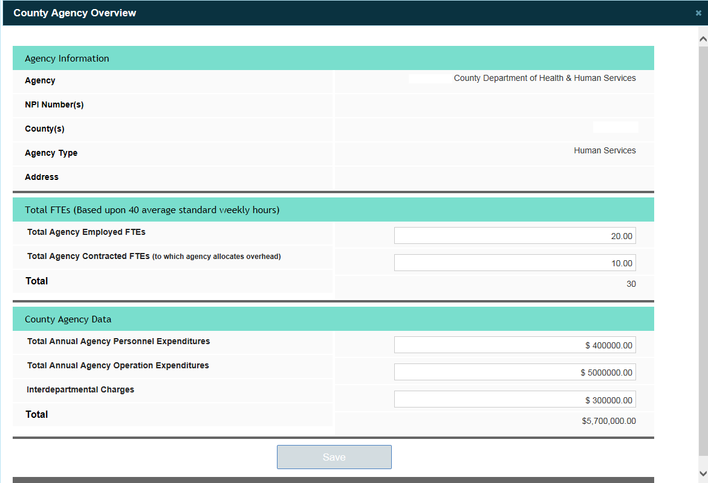
CCS/WIMCR County Agency Overview
Agency info (prepopulated)
FTEs
Cost data

Slide 43
County Agency Overview: Desk Review
Required Field Left Blank.
If no value has been entered in the Total Annual Agency Personnel Expenditures, Total Annual Agency Operations Expenditures, or Interdepartmental Charges field, the WIMCR webtool will trigger an edit requiring an explanation. Multi-county agencies will not see an edit relating to interdepartmental charges.
Total Cost Per FTE Is Unusually Low.
Total agency-wide cost divided by total reported FTEs falls below the expected threshold.

Slide 44
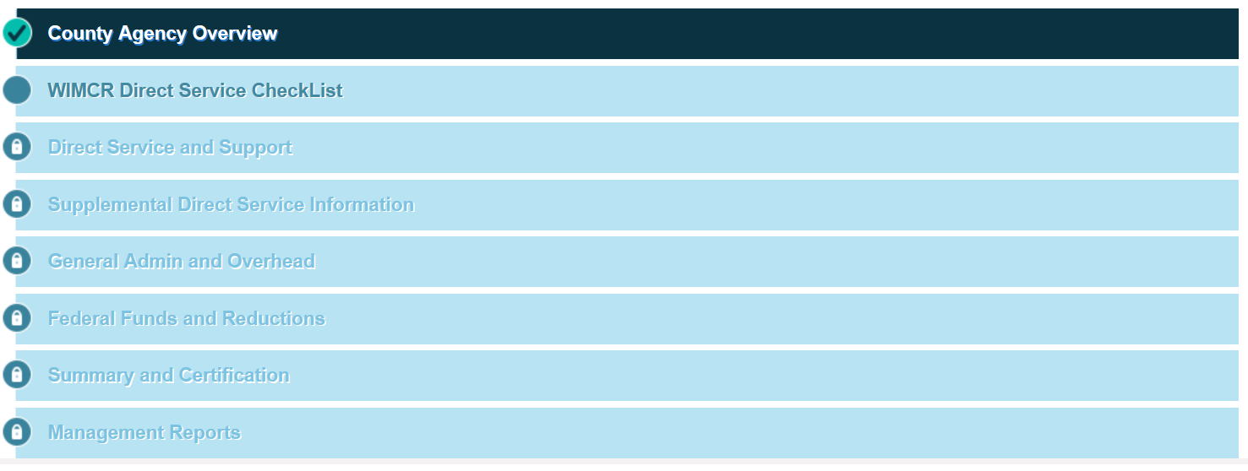
WIMCR Direct Service Checklist

Slide 45
WIMCR Direct Service Checklist
The Direct Service Checklist screen is where an agency will report:
  WIMCR programs.
  Provider IDs.
  Professional types.
Direct Service Checklist is the driver that determines which programs and professional types will be reflected on a particular agency’s WIMCR cost report. Selections made in this section will define the structure of the WIMCR cost report.
It is critical that the WIMCR programs and professional types reflected on the Direct Service Checklist are accurate and comprehensive.

Slide 46
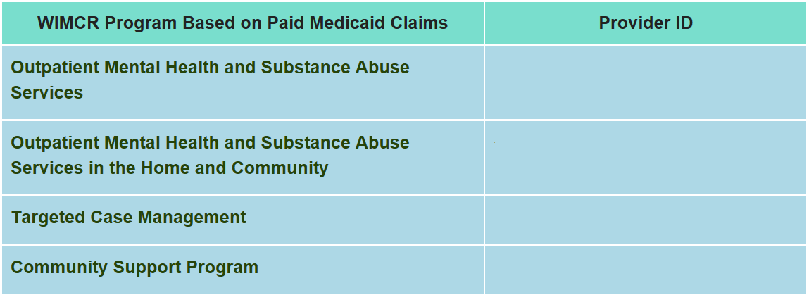
WIMCR Direct Service Checklist
WIMCR Program Based on Paid Medicaid Claims field is a locked field that is not editable by the provider.
The system will prepopulate this field with the provider IDs and program names of all known provider IDs associated with a particular agency for which Medicaid claims have been submitted.
111111111
222222222
333333333
444444444

Slide 47
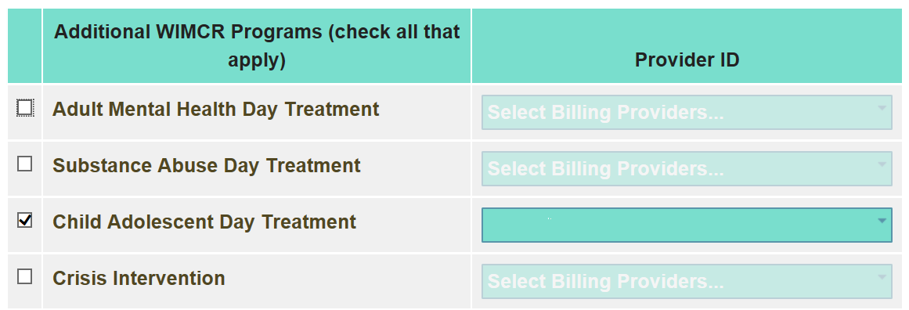
WIMCR Direct Service Checklist
The Additional WIMCR Programs checklist allows the provider to indicate any additional WIMCR programs and provider IDs that were not included in the Medicaid Programs Based on Paid Claims list.
111111111, 222222222

Slide 48
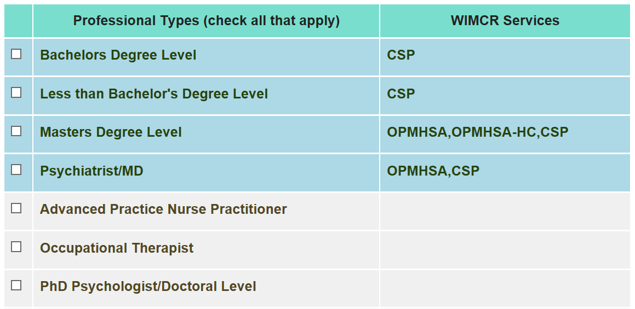
WIMCR Direct Service Checklist
The Professional Types checklist allows the provider to indicate the professional types of all staff providing WIMCR services.
Professional types relating to programs for which claims have been submitted will be populated at the top of the screen.
111111111, 222222222

Slide 49

WIMCR Direct Service Checklist: Certification
Certification of the WIMCR direct service checklist electronically submits selected professional types and programs.
Checklist certification warning: By clicking to certify all WIMCR services and professional types, you are verifying that the list of WIMCR programs and professional types selected above is accurate and complete.
You will not be able to update your direct service checklist screen without contacting PCG at wimcr@pcgus.com or (866) 803-8698. Future updates to your direct service checklist screen may result in the loss of data.

Slide 50
Direct Service Checklist: Desk Review
Missing Provider ID
  Please enter a provider ID corresponding to each WIMCR service selected from the WIMCR Programs Checklist.
Unallowable Professional Type/Program Combination
  There must be one professional type selected with the appropriate credentials to provide each WIMCR service selected.
Professional Type With Corresponding Paid Claims Not Selected
  If there is paid claims data associated with a particular professional type and agency, that agency is required to enter cost data associated with the professional type or provide an explanation.

Slide 51
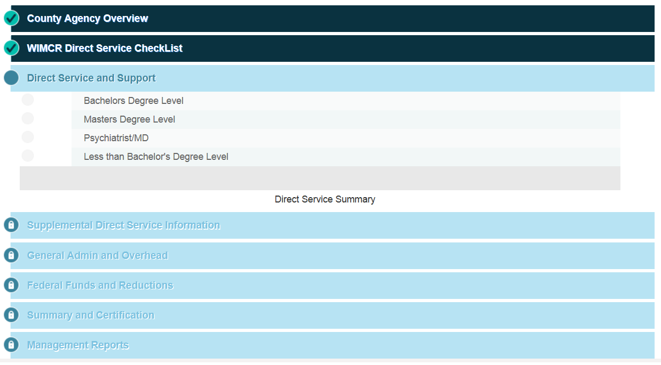
CCS/WIMCR Direct Service and Support

Slide 52
CCS/WIMCR Direct Service and Support
The Direct Service and Support Data by Professional Type pages of the cost report allow for the reporting of all personnel costs (salary, benefit, or contract) for the direct service clinicians who are:
  Employed by the county.
  Under contract with the county agency.
A separate page will be available for each professional type identified on the Professional Type Checklist within the WIMCR Direct Service Checklist page.
The user is able to begin entering data for a specific professional type by selecting that professional type from the list shown on the Direct Service and Support page.

Slide 53
CCS/WIMCR Direct Service and Support
For each professional type, the user will need to navigate through four separate screens:
  Professional Type Basic Information
  Professional Type Cost
  Professional Type Hours
  Professional Type Direct Service Time Allocation Statistics
Once a user has completed a screen, he or she may go back to edit that screen; however, a user cannot complete the succeeding screen before completing the preceding screen.
A progress bar at the top of each of the four WIMCR direct service professional type screens will indicate the status of the WIMCR cost report for each direct service professional type.

Slide 54
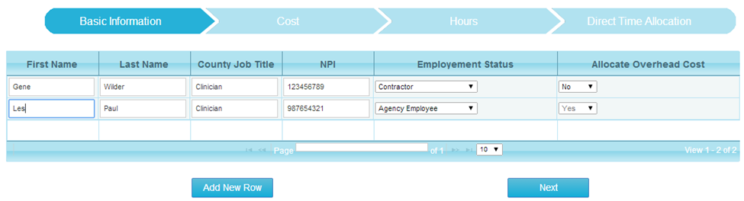
CCS/WIMCR Direct Service: Basic Information
Professional Type Basic Information screen
Data fields
  First Name (mandatory field) and Last Name (mandatory field)
  County Job Title (optional field)
  Provider NPI (optional field for WIMCR and CCS*): unique 10-digit NPI number
    *NPI is not an optional field for CCS regional shared employees.
  Employment Status (mandatory field): Indicate directly employed clinicians (Agency Employee) or contracted clinicians (Contractor).
  Allocate Overhead Cost (mandatory field): Identify whether overhead cost is allocated to each contracted clinician. Defaulted to “Yes" for agency employees.

Slide 55
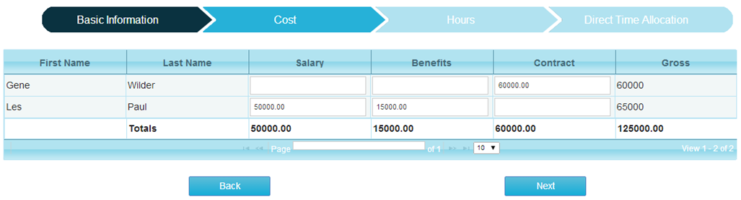
CCS/WIMCR Direct Service: Cost
Professional Type Cost screen
Data fields
  Salary and Benefits for Agency Employees
  Contract Cost for Contracted Clinicians

Slide 56
CCS/WIMCR Direct Service: Cost
Data Fields (Continued)
Salary: Report the gross salary amounts paid to agency employees.
  Inclusive of all cost from which payroll taxes are deducted.
  These include regular wages or extra pay, paid time off (e.g., sick or annual leave), overtime, bonuses or longevity, stipends, cash bonuses, and/or cash incentives.
Benefits: employer share of benefits.
  These include employer-paid health/medical, life, disability, or dental insurance premiums, as well as employer-paid child day care for children of employees paid as employee benefits on behalf of your staff, retirement contributions, and worker’s compensation costs.
Contract Cost: Report any costs incurred for the purchase of professional services provided by staff identified as a contractor.
  Contracted staff costs include compensation paid for services contracted by the county agency with any outside agency or individual (such as an independent clinician).

Slide 57
CCS Intergovernmental Agreements
Intergovernmental agreements
  An intergovernmental agreement occurs when an employee of one county or tribal reporting entity provides services on behalf of a second reporting entity and the second reporting entity reimburses the first reporting entity for services provided. The graphic on the next slide shows an example intergovernmental agreement.
Regional shared
  The term “regional shared” is used to identify an individual or a category of overhead used to support multiple counties.
Revenue offset
  A revenue offset is the dollar amount paid from one county to another for services provided by a regional shared clinician or overhead provider.

Slide 58
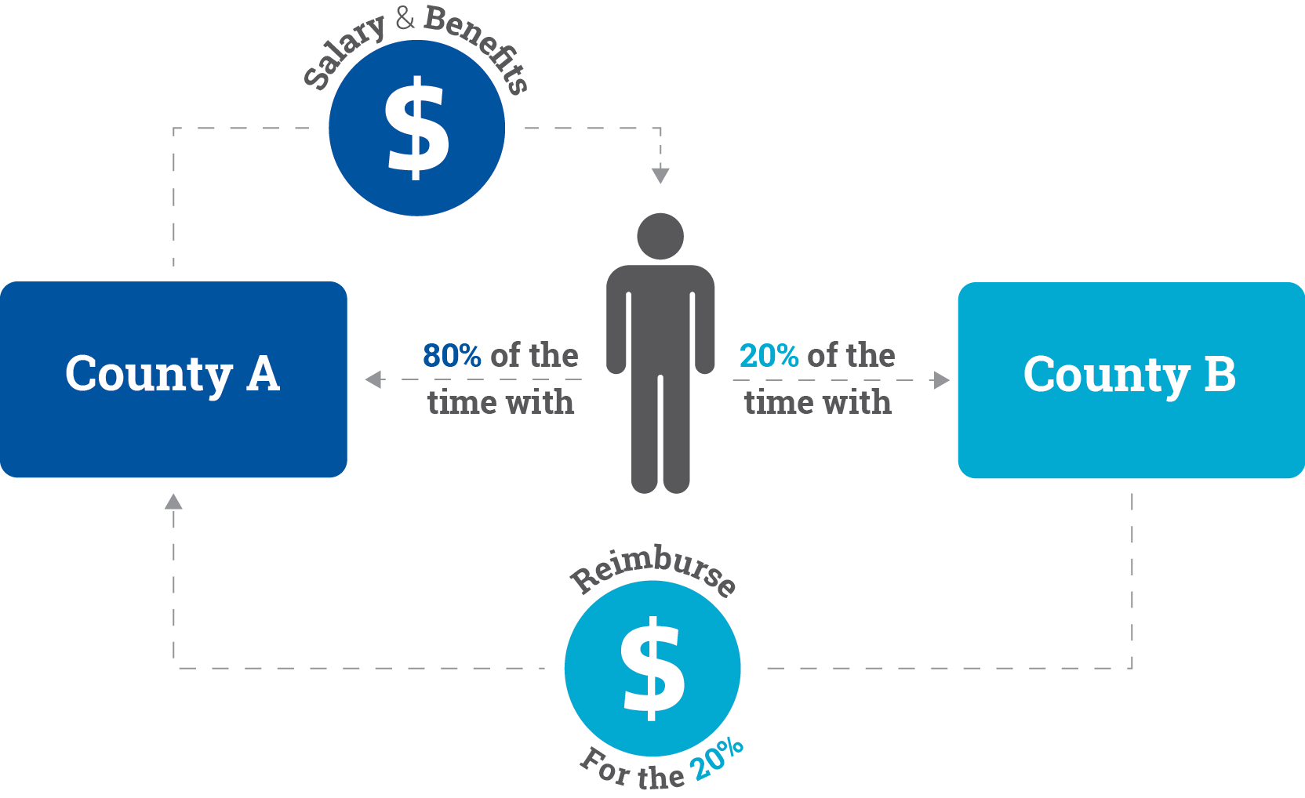
CCS/Intergovernmental Agreements (Continued)

Slide 59
CCS/ WIMCR Direct Service: Cost Desk Review
Salary/benefits/contract cost is unusually high.
  Salary/benefits/contract costs listed for an individual clinician exceed the expected threshold.
Benefit-to-salary ratio is unusually high.
  Benefits for an individual clinician are more than an established percentage of salary cost, which is unusually high.
Salary or contract cost missing.
  Please enter a [contract/salary] cost for an individual clinician.
Salary with no benefits.
  No benefit cost reported for an individual clinician.

Slide 60
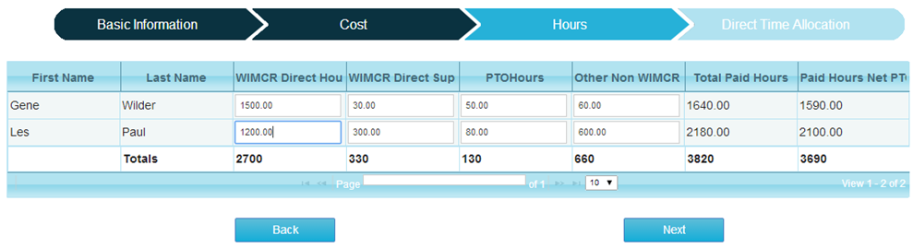
CCS/WIMCR Direct Service – Hours
Professional Type Hours screen
Data fields
  WIMCR Direct Hours: Input the hours providing direct medical WIMCR services in this field. Direct services are those that would be billable to Medicaid if all recipients were Medicaid eligible. WIMCR Direct Time includes:
    Face-to-face medical services
    Medicaid allowable activities included in the applicable ForwardHealth Online Handbook

Slide 61
CCS/WIMCR Direct Service: Hours
Data fields (continued)
WIMCR Direct Support Hours: All time spent on a WIMCR program (aside from WIMCR Direct Hours providing face-to-face medical services), including:
  WIMCR program supervision
  WIMCR planning and coordination
  WIMCR administration
  WIMCR clerical support
Paid Time Off (PTO): includes sick time, vacation time, and personal time used by the employee during the reporting period
Other Non-WIMCR Hours: includes all other paid hours supporting any program or activity outside of WIMCR
  Includes time spent on CRS and CCS programs

Slide 62
CCS/WIMCR Direct Service: Hours Desk Review
Hours reported for all personnel are unusually low.
      The total paid hours reported for all staff are unusually low.
WIMCR Direct hours are unusually high.
  The ratio of WIMCR Direct Hours to Total Paid Hours exceeds the established threshold.
Total paid hours unusually high.
  The total paid hours reported for an individual clinician are unusually high.
Cost per paid hour is unusually high/low.
  Total cost divided by total paid hours for an individual clinician is unusually high or low.

Slide 63
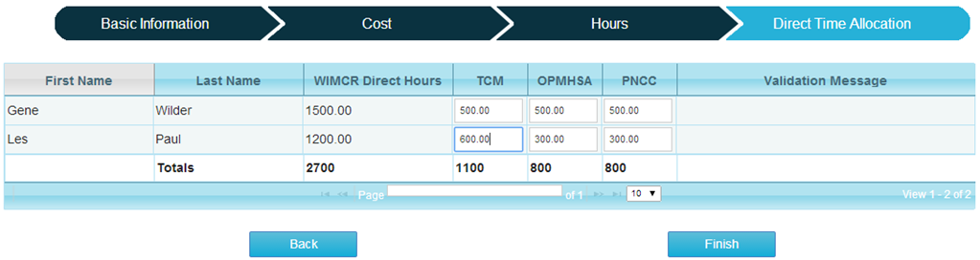
CCS/WIMCR Direct Service – Direct Time Allocation
Professional Type Direct Time Allocation screen
Data fields
  WIMCR Direct Hours: prepopulated based on the WIMCR Direct Hours reported on the Professional Type Hours screen.
  WIMCR Program fields: The user will have the ability to enter the total WIMCR Direct Hours for each program available for the professional type based on the WIMCR programs selected on the WIMCR Direct Service Checklist.

Slide 64
CCS/WIMCR Direct Service Direct Time
Allocation: Desk Review
Paid hours allocated do not equal WIMCR direct hours.
  All reported WIMCR direct hours must be allocated among WIMCR programs for each clinician.
Medicaid paid claims exceed WIMCR direct hours.
  Medicaid paid claims (converted to hours) exceed WIMCR direct hours for a [professional type (if applicable)] staff providing [WIMCR program] services.

Slide 65
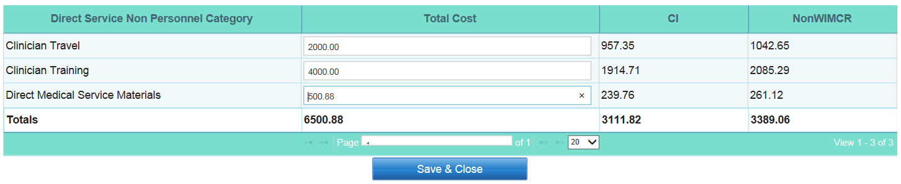
CCS/WIMCR Direct Service Non-Personnel
WIMCR Direct Service Non-Personnel screen
Data fields
  Clinician Travel: expenses for a clinician to travel to and from a location for the provision of a direct service, including mileage expenses, tolls, meals, lodging, and other similar expenses
  Clinician Training: expenses related to the training of direct service clinicians, including conference attendance and continuing education
  Direct Medical Service Materials: expenses for the purchase of materials and supplies that are used in the provision of a Direct WIMCR service

Slide 66
CCS/WIMCR Direct Service Non-Personnel
Direct Service Non-Personnel Reporting Instructions:
Users will report the total cost for each category of direct service non-personnel.
Non-personnel costs will not be allocated to each individual clinician. Cost should reflect total for all reported clinicians.
The expenses will be allocated to each of the defined WIMCR program and Non-WIMCR fields based on the distribution of the WIMCR direct service program and Other Non-WIMCR hours as reported on the Direct Service Data by Professional Type pages.

Slide 67
WIMCR Direct Support
WIMCR Direct Support: In addition to WIMCR direct service clinicians, many agencies employ staff who are focused specifically on providing Direct Support services to the WIMCR program; however, they do not provide a WIMCR Direct Service at any point.
WIMCR Direct Support hours should include all time spent on a WIMCR program, aside from WIMCR Direct Hours (providing face-to-face medical services).
Direct Support Services include:
  WIMCR program supervision.
  WIMCR planning and coordination.
  WIMCR administration.
  WIMCR clerical support.

Slide 68
WIMCR Direct Support
In order to qualify as a WIMCR Direct Support provider, an individual must meet the following two criteria:
  Does not provide a WIMCR Direct face-to-face service: Individual clinicians who provide a direct service in addition to direct support should be reported under the appropriate direct service professional type.
  Spends at least 25 percent of his or her time providing WIMCR direct support activities: General agency support staff who spend fewer than 25 percent of their paid hours supporting the WIMCR program should be reported within Overhead Personnel.
WIMCR Direct Support providers meeting the above criteria are reported individually.
The cost reporting process for direct support providers mirrors the reporting process for direct service clinicians.

Slide 69
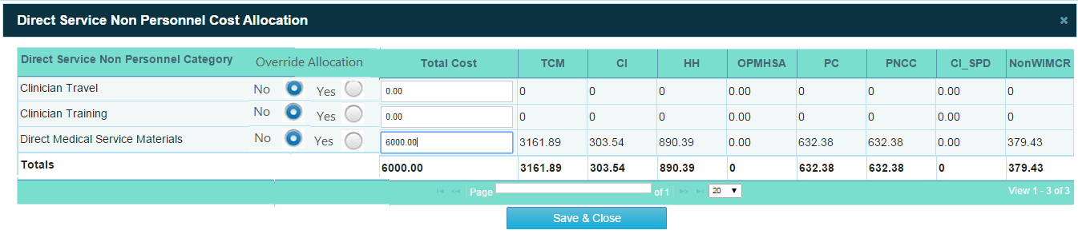
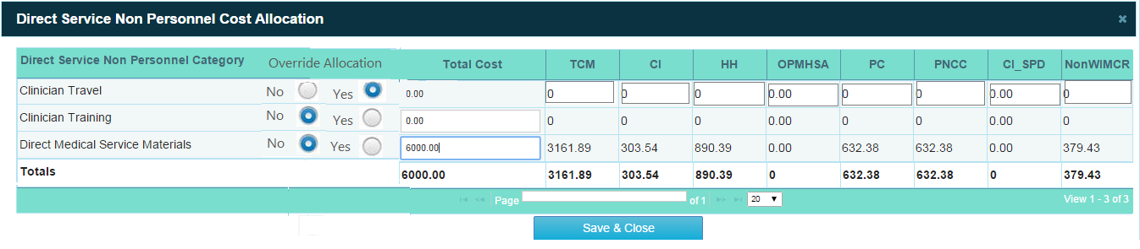
WIMCR Direct Support and CCS/WIMCR Direct Service Non-Personnel

Slide 70
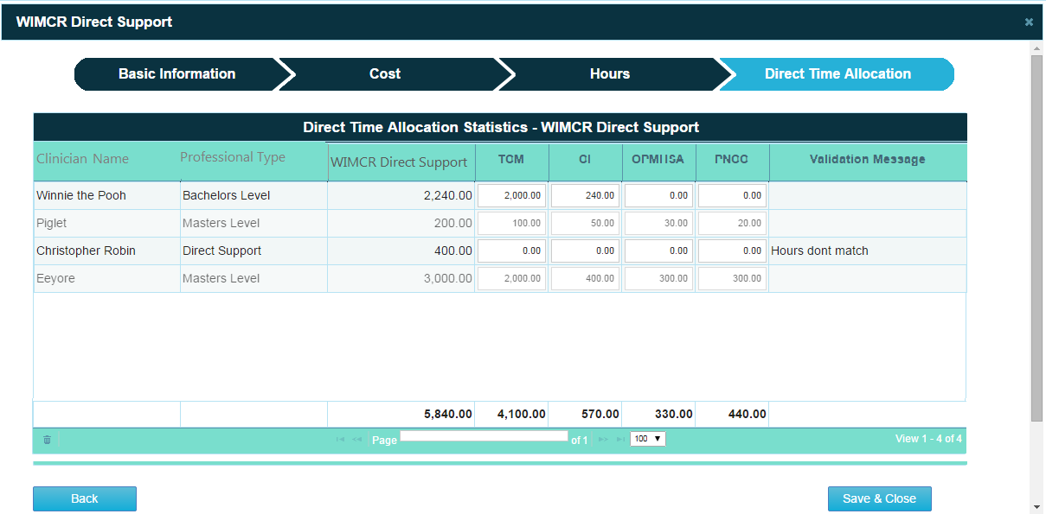
WIMCR Direct Support

Slide 71
Direct Service Non-Personnel and Direct
Support: Desk Review
(Non-Personnel) Non-personnel cost to salary and benefit, or contract cost ratio, is unusually high.
  The ratio of direct non-personnel cost to personnel cost is unusually high.
(Direct Support) All professional type basic information, cost, and hours desk review checks.
  Direct support reporting mirrors direct service reporting; consequently, the same edit checks are applicable.
(Direct Support) Ratio of WIMCR Direct Support Hours to total paid hours is below required threshold.
  In order to qualify as a direct support provider, an individual must spend at least 25 percent of his or her paid hours on WIMCR direct support activities.

Slide 72
WIMCR Direct Service Summary
Direct Service Summary: Once the data has been entered for the Direct Service and Support, a summary of these costs can be viewed by clicking on the Direct Service Summary box.

Slide 73
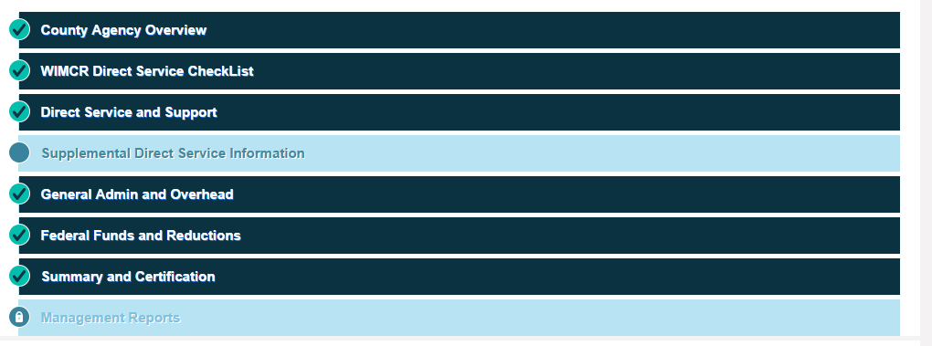
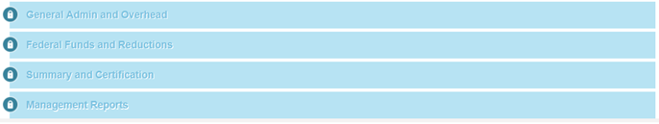
Supplemental Direct Service Information

Slide 74
Supplemental Direct Service Information —
Purpose
Due to the unique structure of each individual CCS/WIMCR program, there is a need for supplemental information relating to several CCS/WIMCR programs.
Each agency will see only the supplemental report screens associated with WIMCR programs that they are providing.
It is possible for an agency to not have access to any supplemental reports.

Slide 75
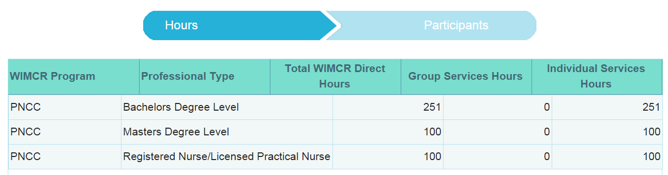
Supplemental Direct Service Information —CCS/WIMCR Group Services
Group Services Hours screen
Data fields
  Direct Hours (Prepopulated): hours providing direct medical WIMCR services, inclusive of Group and Individual services
  Group Services Hours (Open Field — Data Entered by Provider if Applicable): total hours corresponding to each WIMCR Program and Professional Type providing a WIMCR medical service to a group of clients
  Individual Services Hours (Prepopulated): hours corresponding to WIMCR Program/Professional Type for services in an individual setting

Slide 76
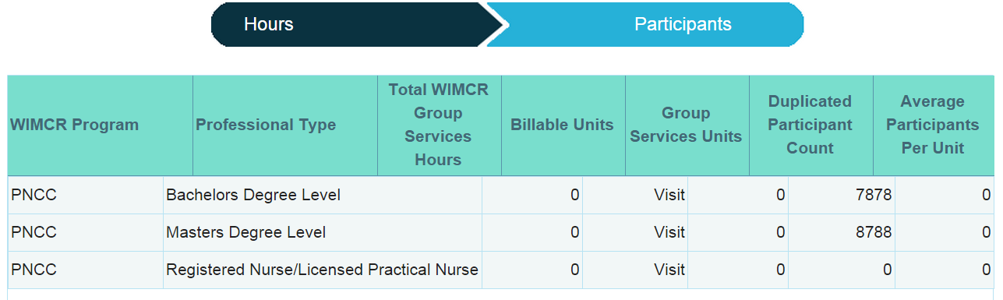
Supplemental Direct Service Info - Group
Group Services Participants screen
Data fields
  Billable Units (Prepopulated): increments in which Medicaid is billed (e.g., 1-hour unit, 15 minute increment, etc.)
  Group Services Units (Prepopulated): prepopulated conversion from total hours reported to total number of units of service provided
  Duplicated Participant Count (Open Field): total duplicated number of participants attending all Group Services Units
  Average Participants Per Unit (Prepopulated): Duplicated Participant Count ÷ Group Services Units

Slide 77
Supplemental Direct Service Info, Group Services: Desk Review
Group service hours exceed direct hours.
  Group service hours exceed direct hours for a professional type.
Paid claims exceed group services hours reported.
  Medicaid paid claims (converted to hours) exceed WIMCR direct hours for staff providing group services within a specific WIMCR program.
Average participants per unit less than two.
  By definition, group services require a minimum of two participants. Services provided to a single individual cannot be billed as a group service.

Slide 78
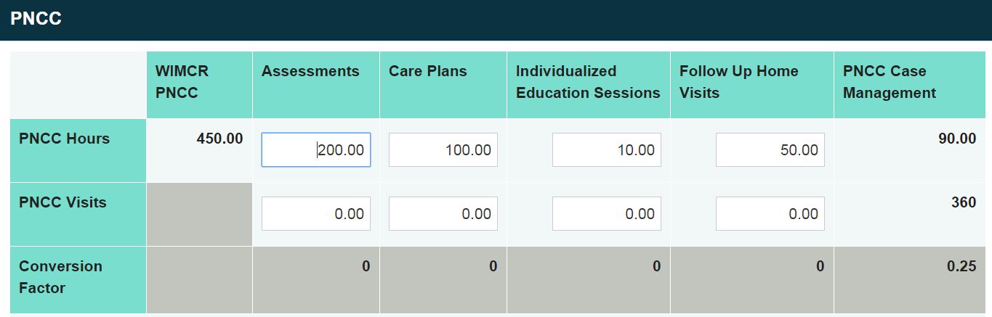
Additional Supplemental Direct Service Info
Additional Supplemental Direct Service Information screen
Additional Supplemental Information screens: will appear if an agency reports prenatal care coordination (PNCC), personal care (PC) nursing services, or home health (HH)
Data fields
  Hours (Prepopulated): hours providing direct medical WIMCR services
  Visits (Open Field): total number of units of service (measured in individual visits) provided to PNCC/PC/HH clients during previously reported PNCC/PC/HH hours.
  Conversion Factor (Prepopulated): hours ÷ visits

Slide 79
Additional Supplemental Direct Service Info: Desk Review
(PNCC only) Hours reported for PNCC visits exceed total PNCC hours.
  Total hours allocated to specific PNCC services exceed WIMCR direct PNCC hours.
(PC, PNCC, HH) Paid claims exceed program hours reported.
  Medicaid paid claims (converted to hours) exceed WIMCR direct hours for a staff providing [WIMCR program] group services.
(PC, PNCC, HH) Conversion factor is outside of expected range.
  The ratio of hours to visits is outside of the expected range. This occurs when an average visit lasts less than half an hour or more than two hours.

Slide 80
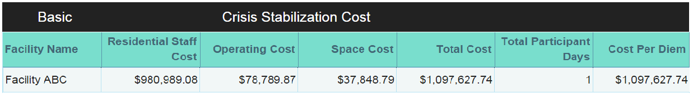
Supplemental Direct Service Info - CS
Crisis Stabilization screen
Data fields
  Name of Facility: Report the name of each facility where Crisis Stabilization services are provided.
  Residential Staff Cost: gross residential facility salary and benefit cost.
  Operating Cost: all non-personnel cost relating to day-to-day facility operations, including contract cost and materials and supplies.
  Space Cost: total cost of residential facility space, including building maintenance and utilities.
  Total Participant Days: total days of service provided at each residential facility during the reporting period.

Slide 81
Supplemental Direct Service Information
CS: Desk Review
Total cost per diem unusually high/low.
  The average cost per diem for Crisis Stabilization services falls outside of the usual range.
Medicaid paid claims exceed total participant days reported.
  Medicaid paid claims for Crisis Stabilization services exceed total participant days per the cost report.

Slide 82
CCS/WIMCR General Administration and Overhead
Overhead Definition
  Commonly reflects central services related to overall agency operations that are allocable to all agency programs, including CCS or WIMCR. General overhead includes general support and general non-personnel.
General Overhead Reporting
  In order to appropriately allocate a portion of each agency’s overhead cost to the CCS/WIMCR program, each agency should report its entire agency-wide overhead cost.
  Overhead will automatically be allocated among the various CCS/WIMCR programs based on the FTE allocation methodology.

Slide 83
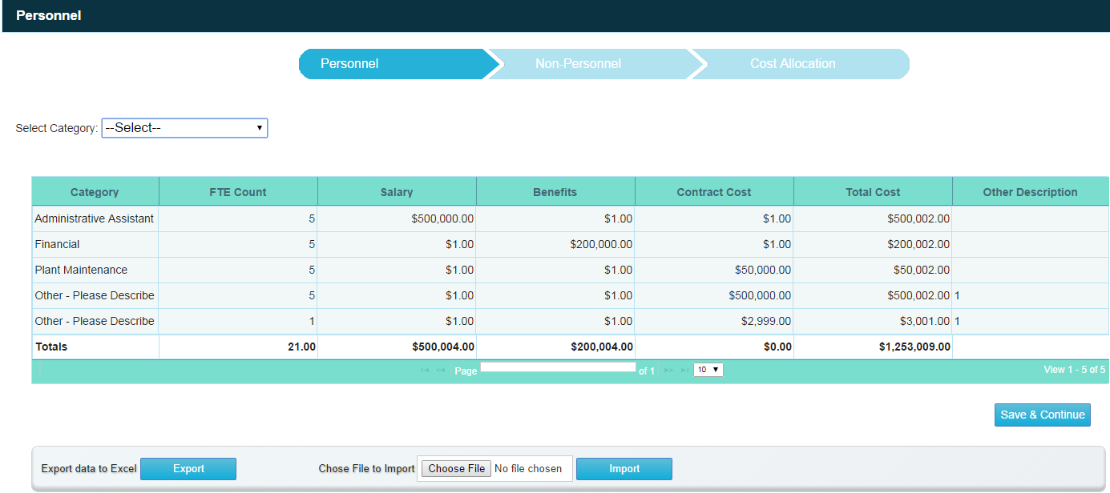
CCS/WIMCR Overhead Personnel
Overhead Personnel screen
Data fields
  Overhead Personnel Cost Category (Dropdown Menu): possible choices: Accounting, Administrative Assistant, Billing, Clerical, Emergency Services, Financial, Human Resources, Legal, Plant Maintenance, Program Administrator, Program Director, Other - Please Describe.
  FTE Count: total FTEs applicable to each Overhead service. One FTE is equal to 40 hours per week and 2,080 hours per year.
  Salary, Benefits, Contract Cost and Gross: See direct service cost.

Slide 84
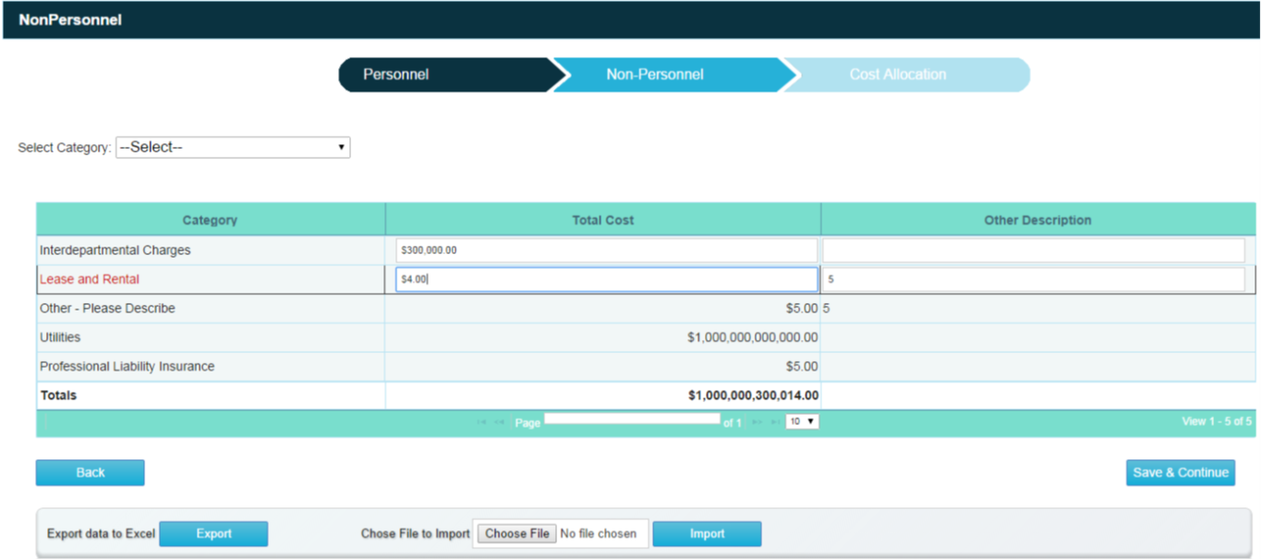
CCS/WIMCR Overhead Non-Personnel
Overhead Non-Personnel screen
Data fields
  Overhead Non-Personnel Cost Category (Dropdown Menu): possible choices: Lease and Rental, Office Supplies, Insurance, Utilities.
  Total Cost: total cost for the agency per category of overhead.
  Interdepartmental Charges: Reported on County Agency Overview Page. A lump-sum portion of county-wide overhead cost allocated to a particular county agency.

Slide 85
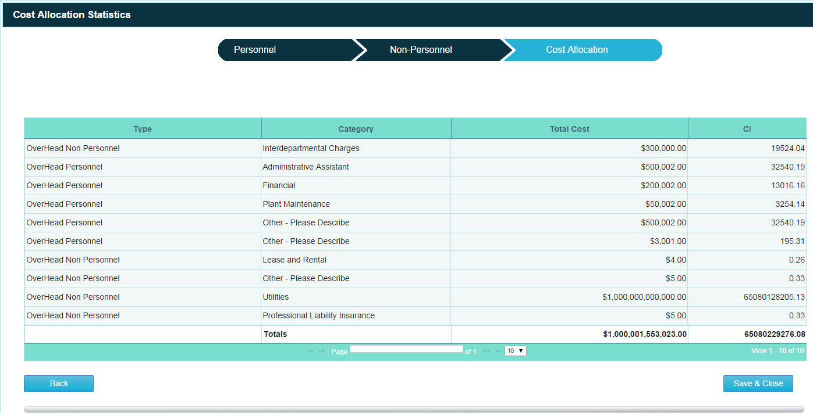
Overhead Allocation
Overhead Cost Allocation: Overhead cost has been automatically allocated to each CCS/WIMCR program and non-CCS/WIMCR based on the FTE method.

Slide 86
Overhead
Cost Reported ÷ Total Agency Wide FTE Net of Overhead
= Overhead
Cost Reported =
Total Overhead Cost x (Direct Service Program hours Net of
Non-Overhead Staff hours + Direct Support Program Hours
net of Non-Overhead staff hours) ÷ 2080
Total Agency Wide FTE Net of Overhead =
Total Agency Wide FTE - Overhead Personnel FTE

Slide 87
Overhead: Desk Review
Reported costs exceed agency-wide cost.
  Sum of Direct Service Program Hours plus Direct Support Program Hours plus Overhead Personnel Salary and Benefit Cost is greater than Agency-Wide Expenditures.
  Difference of Overhead Non-Personnel minus Intergovernmental Charges is greater than Agency-Wide Operation Expenditures.
Total cost per FTE unusually high/low.
Unusually high overhead.
  Ratio of total overhead cost (personnel plus non-personnel) allocated to CCS/WIMCR divided by all CCS/WIMCR costs is greater than expected threshold (above expected but below unallowable).
  Ratio of total overhead cost (personnel plus non-personnel) allocated to CCS/WIMCR divided by all CCS/WIMCR costs is greater than unallowable threshold.

Slide 88
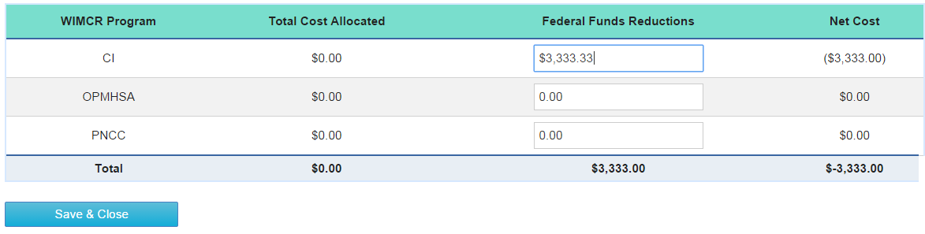
CCS/WIMCR Federal Funds and Reductions
Federal Funds screen
Data fields
  Total Allocated Cost: includes previously reported direct service cost, direct support cost, and overhead cost, which have been allocated to each individual CCS/WIMCR program.
  Federal Funds and Reductions: Identify any federal grant dollars applied to offset the cost of your agency's CCS/WIMCR programs.
  Net Cost: Total Allocated Cost: Federal Funds and Reductions (system generated).

Slide 89
CCS/WIMCR Federal Funds Examples and
Desk Reviews
Federal Funds Examples
  CCS/WIMCR providers are required to report the receipt of federal grant funding that is used to offset the cost of a CCS/WIMCR program.
  Federal dollars include, but are not limited to:
    Substance Abuse Block Grant.
    Mental Health Block Grant.
    Social Services Block Grant.
Desk Review
Federal funds exceed total program costs.
The total value of federal funds used toward a specific CCS/WIMCR program cannot be greater than the cost of the entire CCS/WIMCR program.

Slide 90
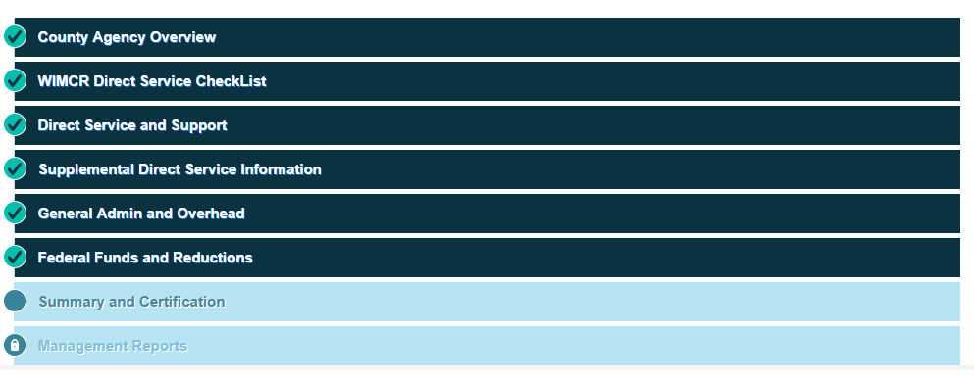
Summary and Certification

Slide 91
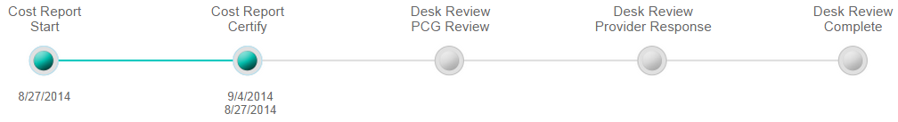
CCS/WIMCR Summary and Certification
Summary and Certification: General Information
  This page outlines the summary of all costs entered in the cost report.
  Links are available to additional summary data by program and category.
  By clicking on Certify, the county-level administrator is able to certify the cost report.
What happens when a report is certified?
  The following message will appear:
    This report has been completed and it is locked and ready for desk review. No edits can be made to the information. If changes are needed, please contact PCG to have the report certification rolled back.
  The dashboard page will show that the report is certified.

Slide 92
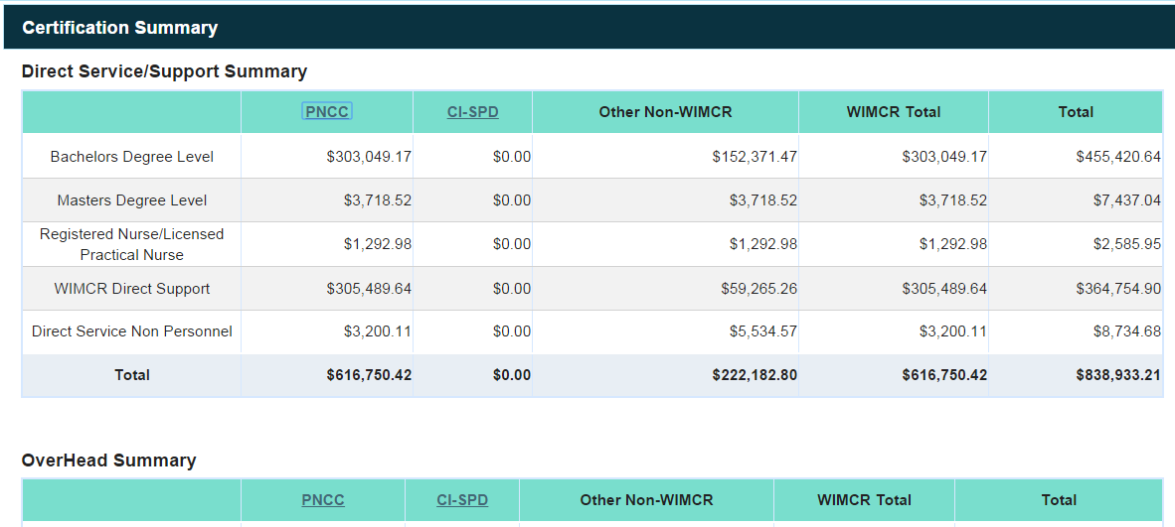
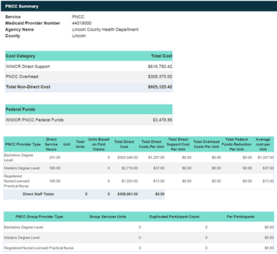
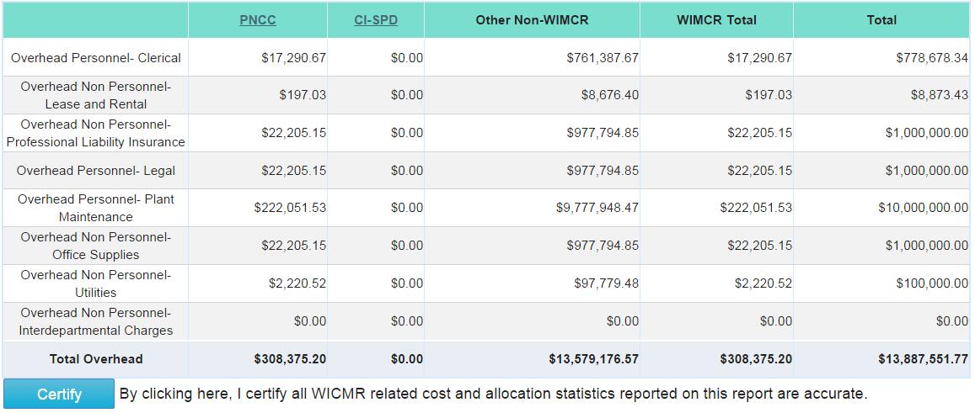
Summary and Certification

Slide 93
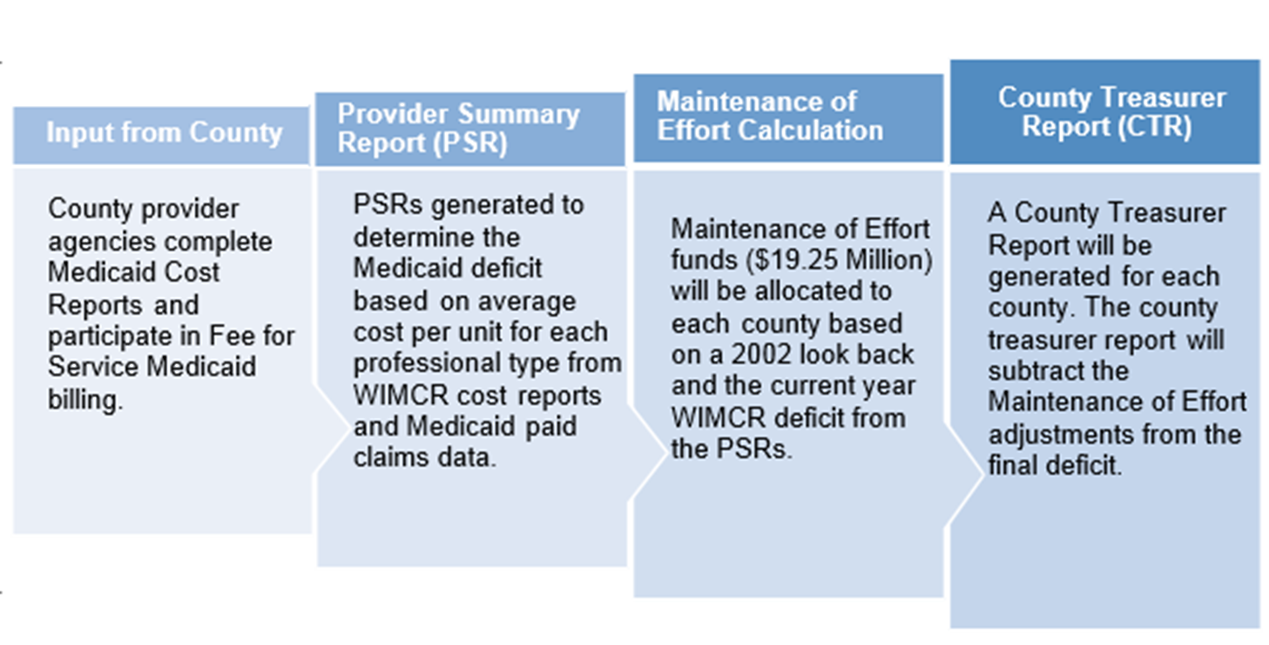
WIMCR Management Reports

Slide 94
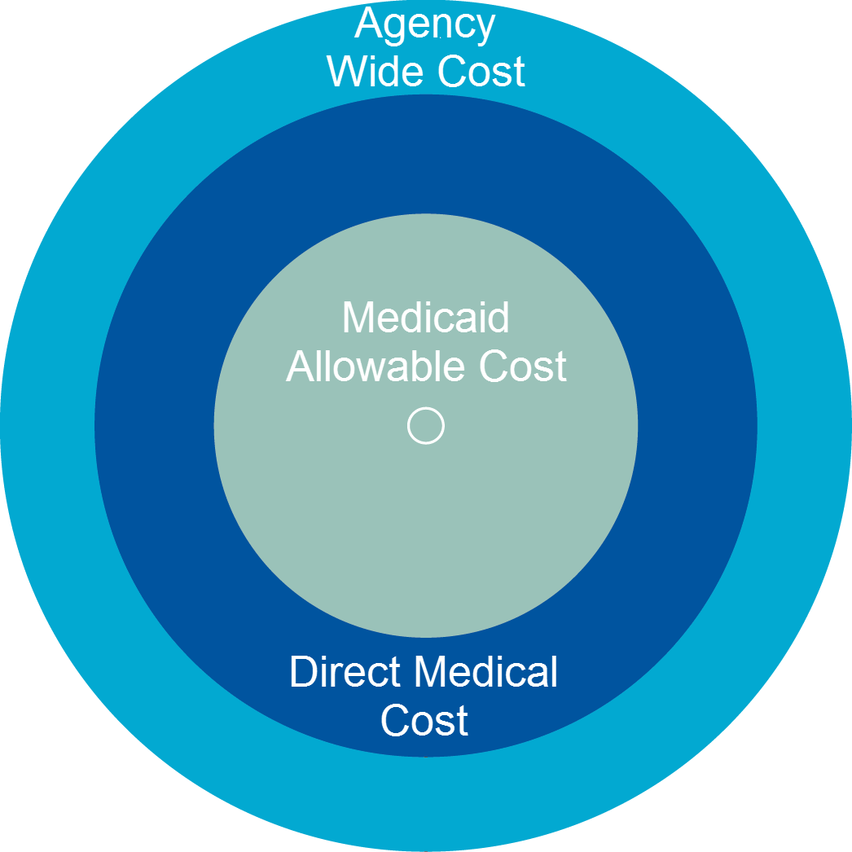
CCS Management Reports
Provider Summary Report (PSR)
  Calculate county cost (cost per unit from cost report).
  Multiply by total Medicaid claims.
  Subtract fee-for-service (FFS) claims.
PSR notes
  PSR structure and calculation vary based on date of regionalization.
  In CY 2014, step 1 value will vary from January–June (legacy method) and July–December (updated method).
Regional reports
  Regional payment summary
  Intergovernmental agreements report

Slide 95
Timeline and Next Steps

Slide 96
CY 2014 CCS Reporting Timeline
Date | Event
May 18, 2015 | CY 2014 CCS tool and guide available
May 18–22, 2015 | Regional CCS cost reporting trainings
May 25–29, 2015 | Additional webinar CCS cost reporting trainings
June 1–August 14, 2015 | Submission of completed CY 2014 CCS reports via email
August 17–September 18, 2015 | Desk reviews for CY 2014 CCS reports
December 2015 | Distribution of CY 2014 management reports
December 2015 | Processing of final CY 2014 CCS payments

Slide 97

WIMCR Timeline

Slide 99
Appendix I: CC/WIMCR Background

Slide 100
CCS/WIMCR Background
Cost-Based Reimbursement
  A cost-based reimbursement methodology determines the actual cost of delivering direct medical services.
Payments made by Wisconsin Medicaid to counties are based on:
  Actual cost-based rate
  Units of service provided to Medicaid-enrolled members

Slide 101
CCS/WIMCR Background
Wisconsin Medicaid Cost Reporting (WIMCR):
Requires annual cost reporting by enrolled public Medicaid providers (i.e., county agencies and local health departments) for certain services.
Brings additional federal funds into Wisconsin through cost-based reimbursement methodology.

Slide 102
Appendix II: CCS Service Array and WIMCR Programs

Slide 103
CCS Background
CCS Service Array
Assessment
Recovery planning
Service facilitation
Communication and interpersonal skills training
Community skills development and enhancement
Diagnostic evaluations and specialized assessments
Employment-related skill training
Medication management
Physical health and monitoring
Psychoeducation
Psychotherapy
Recovery education and illness management
Substance abuse treatment
Other approved service
Psychosocial rehabilitative residential supports per diem

Slide 104
WIMCR Background
WIMCR Programs
Adult mental health day treatment (medical day treatment services)
Substance abuse day treatment
Child adolescent day treatment
Crisis intervention
Crisis intervention (stabilization) per diem
Home health
Personal care
Outpatient mental health and substance abuse services
Outpatient mental health and substance abuse in the home and community for adults
Prenatal care coordination
Case management
Community support program

Slide 105
Appendix III: CCS

Slide 106
CY 2014 Interim Claims Activity
Interim Claims Activity for CY 2014 Dates of Service
Type | State Share | Federal Share | All Funds | Percentage of Total
Non-Regional | - | 7,884,898.28 | 7,884,898.28 | 63%
Regional | 1,910,788.06 | 2,722,283.84 | 4,633,071.90 | 37%
Total | 1,910,788.06 | 10,607,182.12 | 12,517,970.18 | 100%

Slide 107
CY 2015 to Date Interim Claims Activity
Current Interim Claims Activity (January 2015–March 2015)
Type | State Share | Federal Share | All Funds | Percentage of Total
Non-Regional | - | 39,315.52 | 39,315.52 | 4%
Regional | 349,235.48 | 489,430.71 | 838,666.19 | 96%
Total | 349,235.48 | 528,746.23 | 877,981.71 | 100%

